Slide 1

What’s New in Worldview
Zachary Rice
ASRC Federal
SE TIM 2018
August 29th, 2018

Slide 2
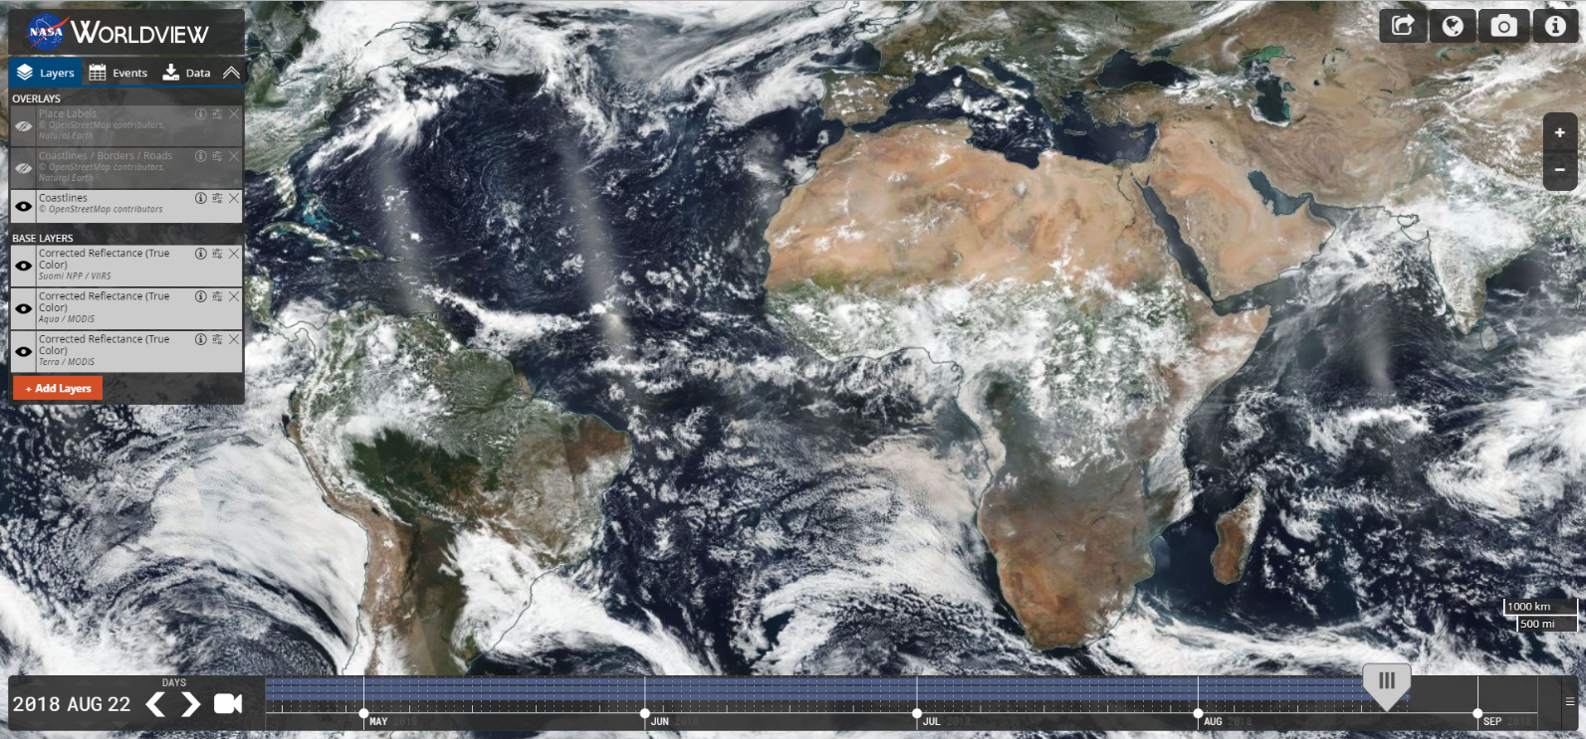




Major Releases
v2.0.0 & v2.1.0
Refactored codebase to use ES6 modules
Simplified build scripts
Improved developer tools
v2.2.0
Improved Snapshot & GIF resolution
v2.3.0
Sub-daily layer support
v2.4.0 & v2.5.0
Multi-day event tracking
v2.6.0
Natural events in polar projection views
v2.7.0
Vector layer support
V2.8.0
Support selecting layers with future dates
v2.9.0 (September 2018)
“A|B” Comparison Mode

Slide 3
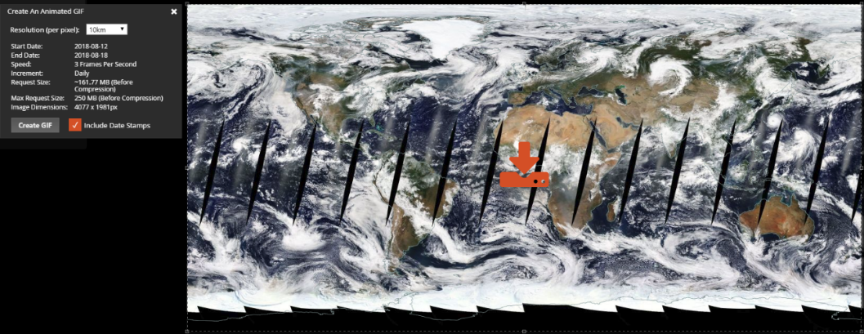
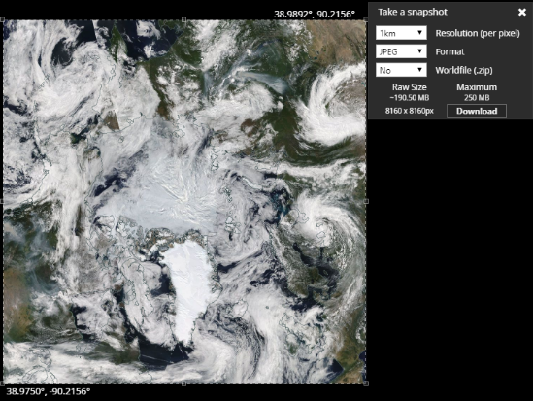
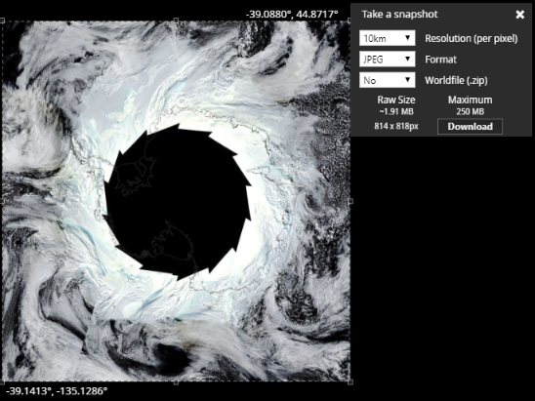
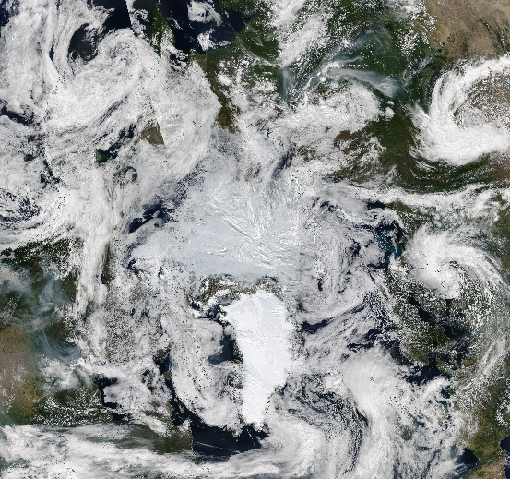
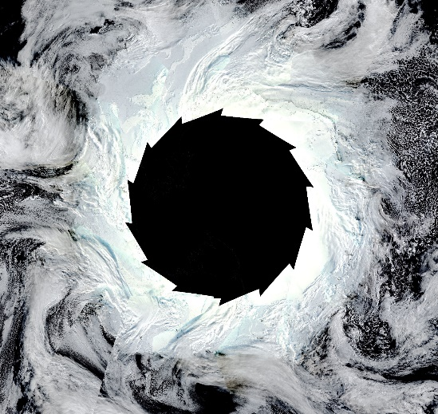
Improved Image Resolution
High-Resolution Animated GIFs
High-Resolution Image Snapshots
7-Day Animation of Geographic Projection at 10km
Arctic & Antarctic Projections at 1km

Slide 4
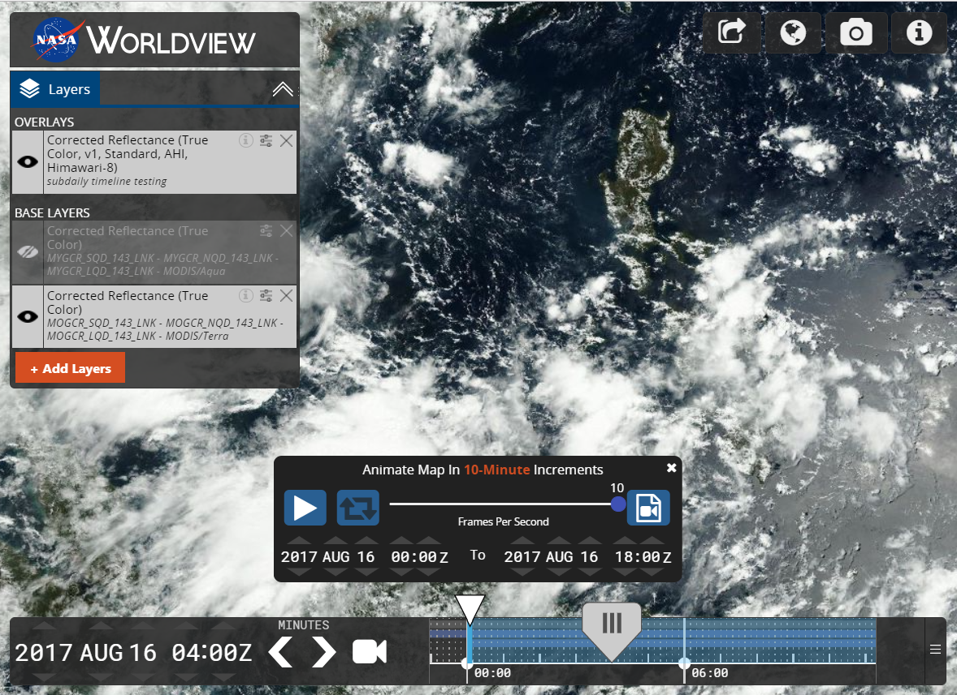
Geostationary Image Support
10-minute timeline granularity for NASA CAMP2Ex field campaign

Slide 5
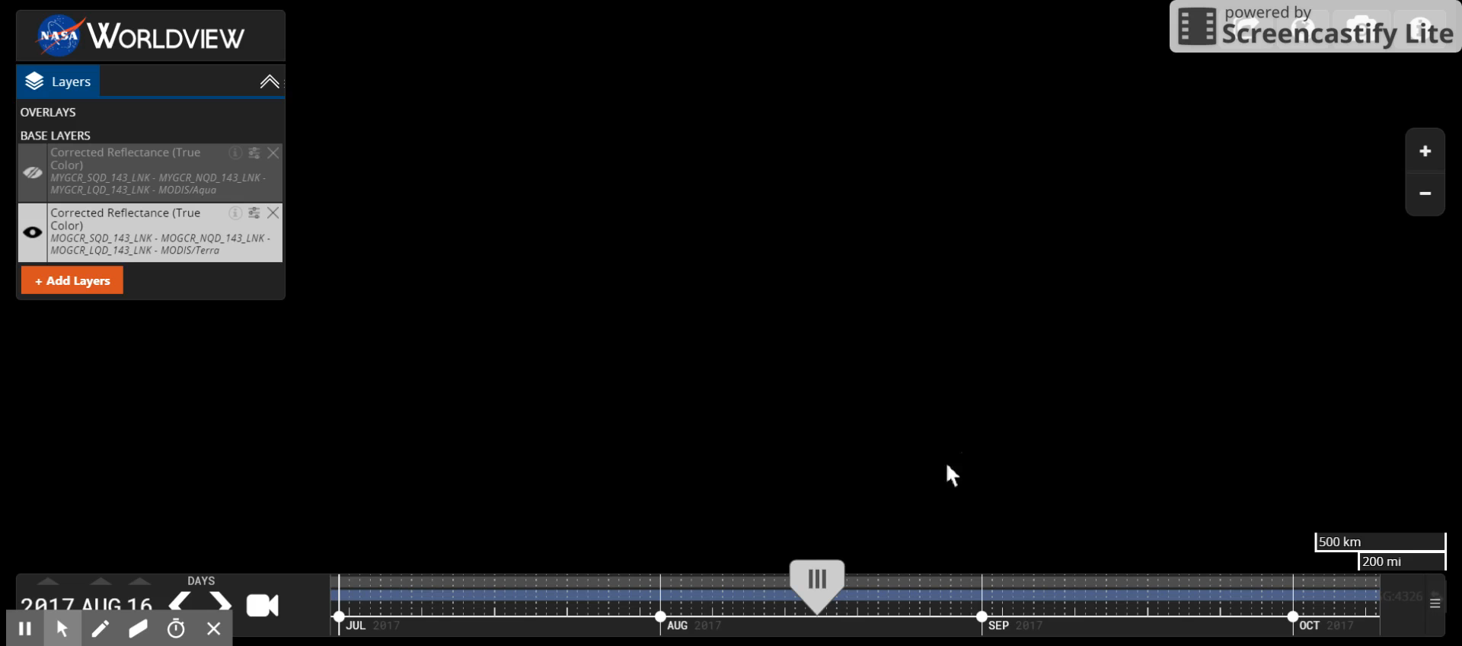
Geostationary Image Support

Slide 6
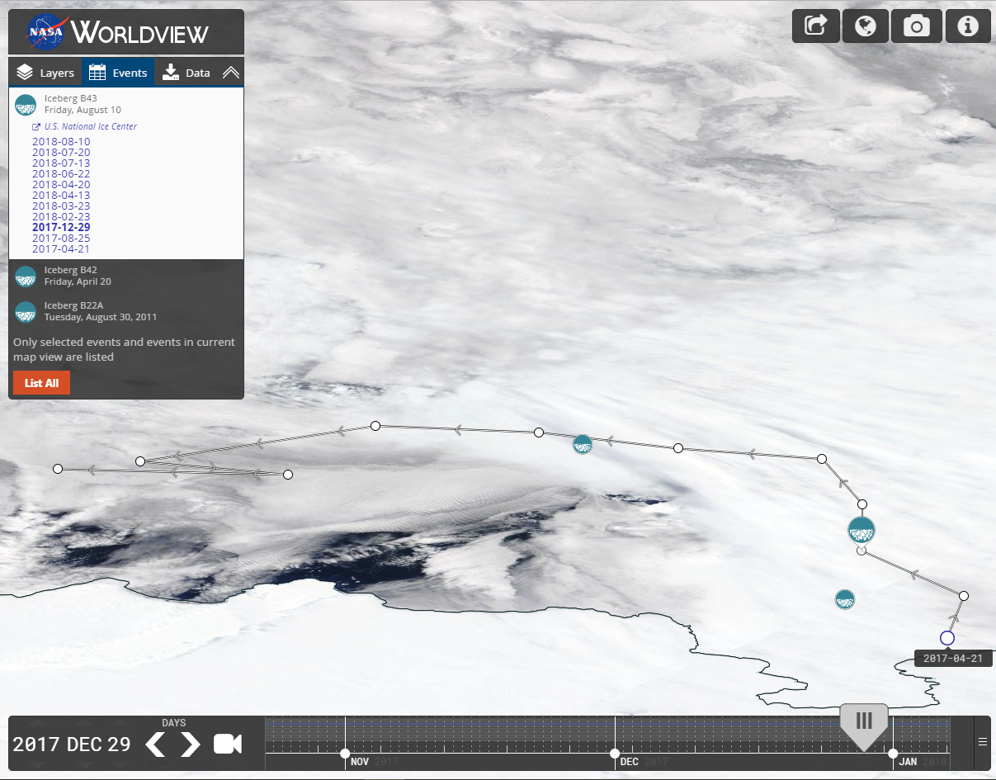
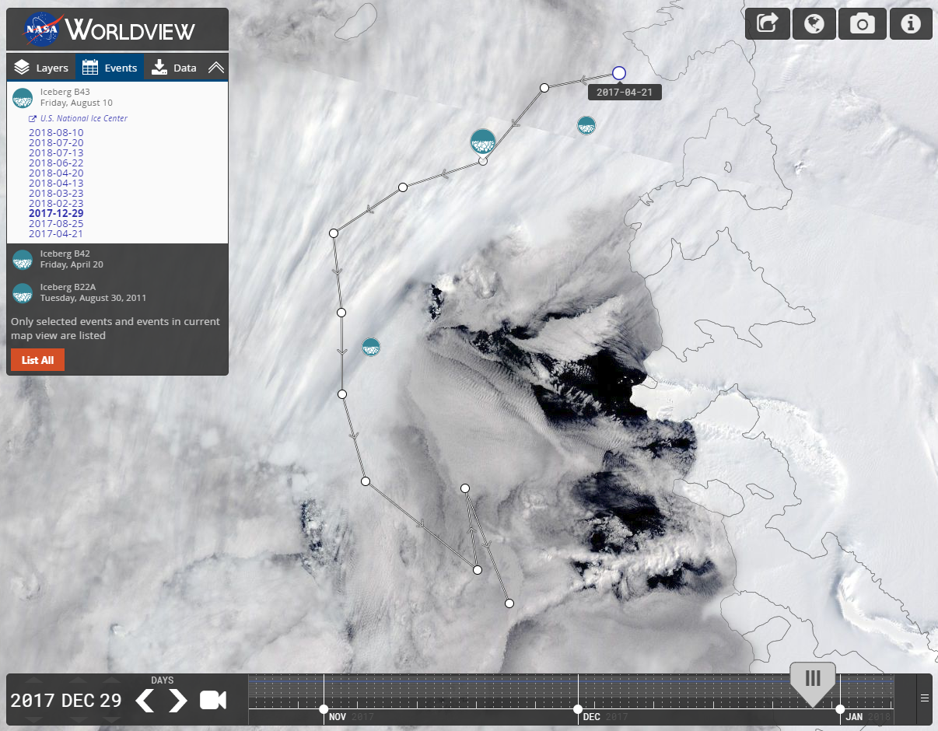
Event Tracks & Polar Events
Event Tracking
Polar Projection Support

Slide 7
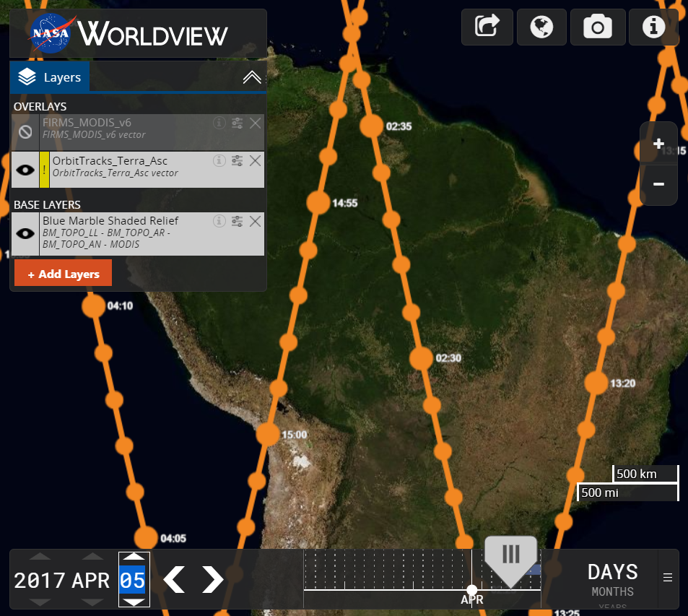
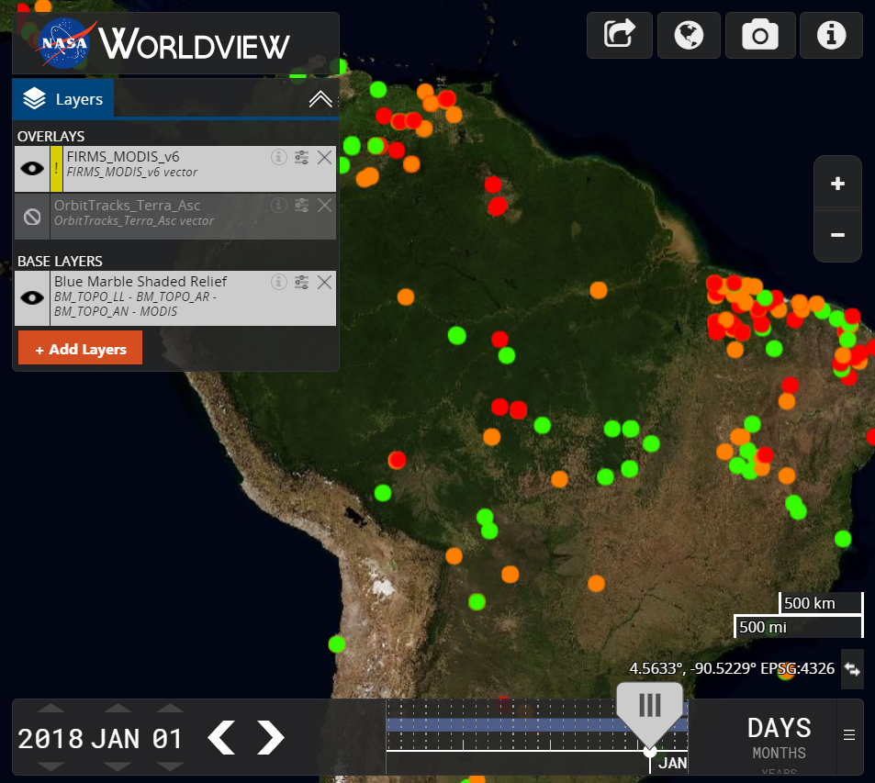
Vector Support
Orbit Tracks
FIRMS MODIS v6 Fires

Slide 8
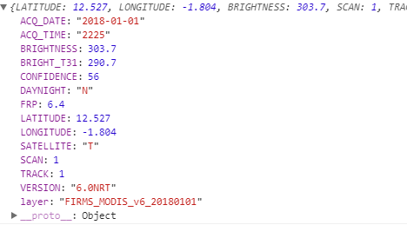
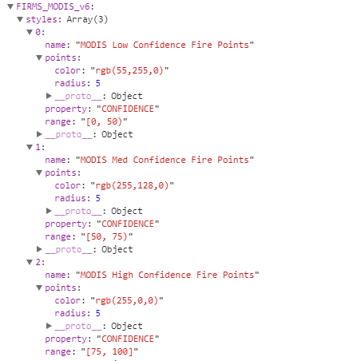
Vector Support
Composing a stylized vector layer
Vector Point Feature Data
JSON Style Data
Match vector feature data to the style JSON data
In the FIRMS_MODIS example, we match “CONFIDENCE”
Based on the CONFIDENCE number, we style with 1 of 3 colors

Slide 9
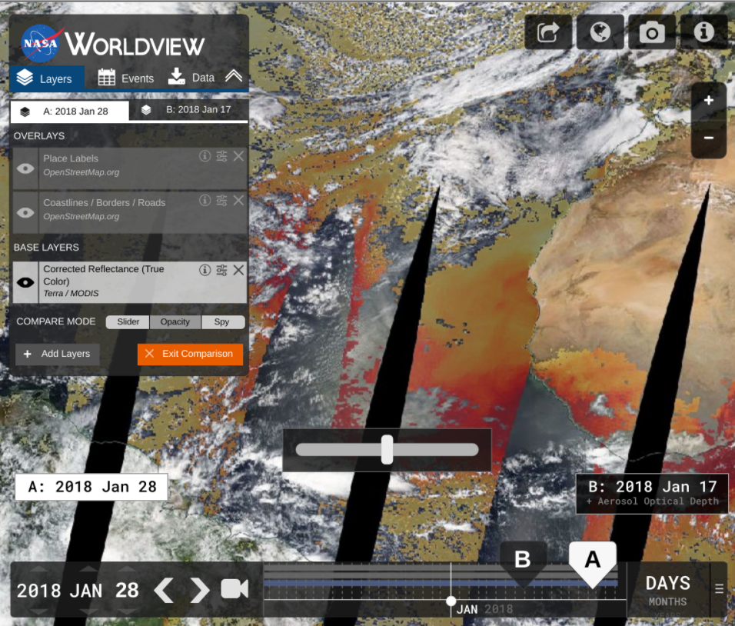
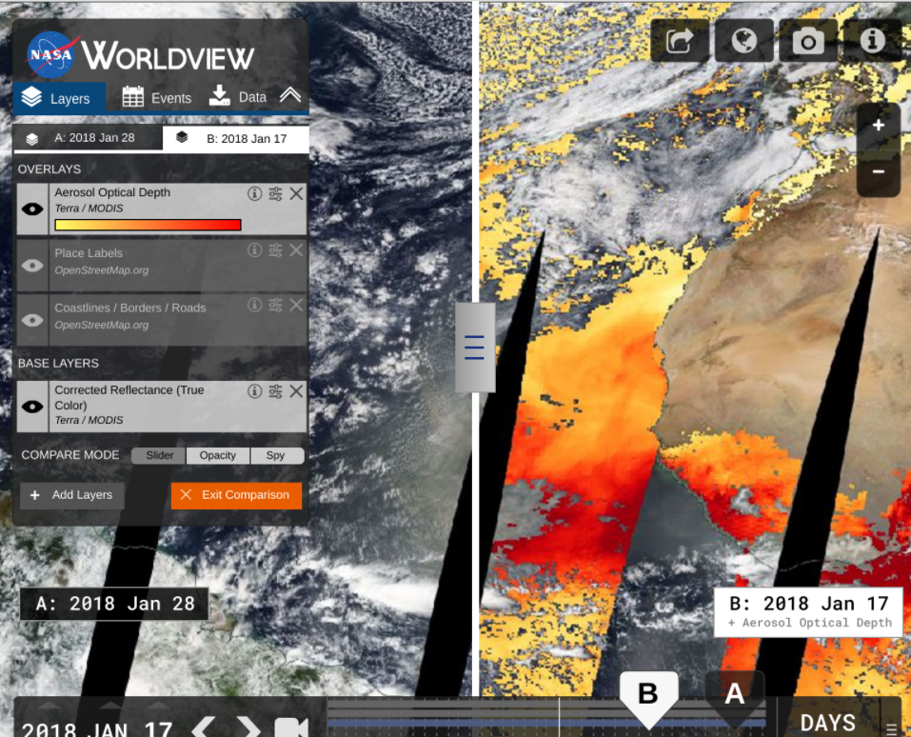
Comparison Mode (Sept 2018)
Opacity Mode
Swipe Mode

Slide 10
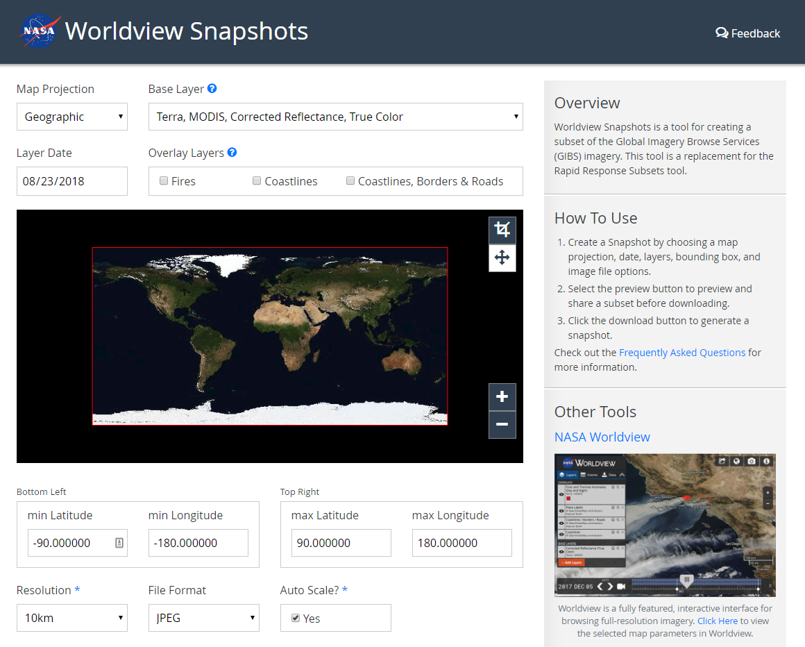
Short-Term Goals
Worldview Snapshots Tool
Startup Tour/Tutorial
Show users new / popular events
Advanced Vector Support
Styling based on vector features
Vector point tooltips
Revamped Image Download
Capture imagery across the dateline
Vector download capabilities
Add additional meta to downloads (legends, color bars, time stamps, etc.)
Updates to OpenStreetMap Layers

Slide 11
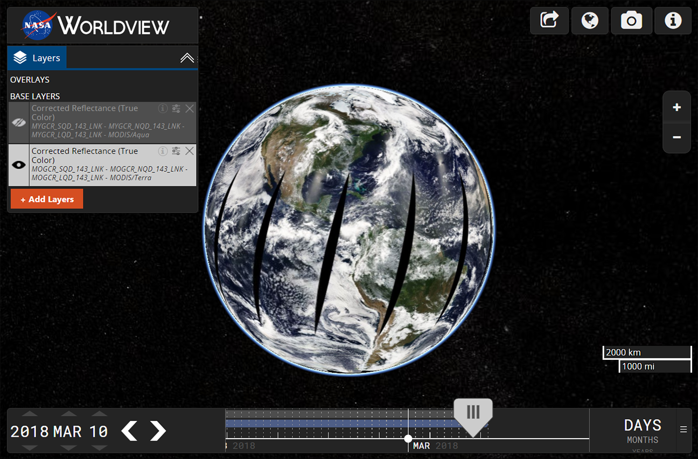
Mid to Long-Term Goals
Historical Event Browsing
Migration to NGAP
UI Overhaul
Improved Data Download
Improved Timeline
Gazetteer / Omni search box
Search for places, lat/long, layers, etc.
User Customization
Save settings, bookmarks, etc.
Crowdsource event information
Virtual Globe / Data Curtains
Add features that support new missions…
Worldview 3D globe concept using Cesium

Slide 12
Thank You
More Resources & Links
Worldview on GitHub: https://github.com/nasa-gibs/worldview Release Notes: https://github.com/nasa-gibs/worldview/releases Project Roadmap: https://github.com/nasa-gibs/worldview/projects/7

